Slide 1
The Spiral Model
Sultana & Mahmood

Slide 2
Systems development life-cycle
The process of creating or altering computer systems
The models that define the processes involved
Framework for the development of a information system

Slide 3
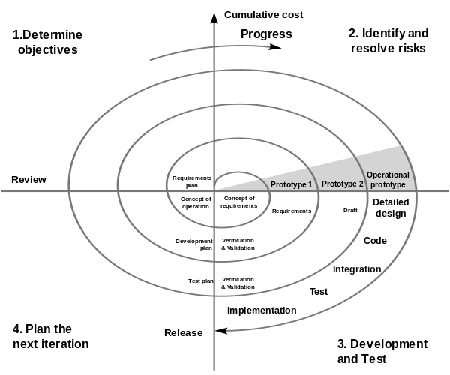
The Spiral model

Slide 4
The Spiral model
Combines design and prototyping stages
It uses concepts from the waterfall model and iterative development model
Systematic nature of waterfall model
Incremental style of iterative development model such as prototyping
Continuous development
Prototypes created early on in cycle
Everything divided into stages

Slide 5
The Stages
1. Objectives and requirements
Decide what you want the system to do
Identify end user goals
2. Design system and Identify risks
Begin designing the system
Start prototyping
Begins with conceptual idea and spirals into a final design

Slide 6
The Stages
3. Construct and build
Prototypes developed to get customer feedback
As the spiral develops, more detail and clarity is added
Which improves customer feedback
System is tested against original requirements
4. Testing and releasing of final prototype

Slide 7
Advantages
Requirements can be easily changed
Extensive prototypes
Users see the system early

Slide 8
Disadvantages
Complicated process
Spiral may never complete
Large number of steps

